Slide 1
Hacking and Computer Forensics
CS 6262 Spring 02 - Lecture #14
(Thursday, 2/21/2002)

Slide 2
How Hackers Prevail
(and You Lose)
Jim Yuill
NC State Computer Science Department
Security Research Group

Slide 3
Hacker Techniques
Find and attack the “weakest link”
Reconnaissance
Gain access to first machine
Use acquired access to gain further access

Slide 4
Disclaimer
Hacking is illegal!
Some actual organizations and computers are used in the examples,
  but only to provide realism
Do not hack the examples!

Slide 5
Reconnaissance
Public information
  www
  news postings
Network Scanning
  Operating System Detection
War-dialing

Slide 6
Public Info: www.internic.net
Domain Name: GATECH.EDU
Registrant:
Georgia Institute of Technology, 258 4TH St, Atlanta, GA 30332
Contacts:
Administrative Contact: Herbert Baines III
GA Institute of Tech (GATECH-DOM), 258 4TH St., Atlanta, GA 30332
(404) 894-0226, herbert.baines@oit.gatech.edu
Technical Contact: OIT, Georgia Tech 258 Fourth Street Atlanta, GA 30332
(404) 894-0226, hostmaster@gatech.edu
Name Servers:
TROLL-GW.GATECH.EDU 130.207.244.251
GATECH.EDU 130.207.244.244
NS1.USG.EDU 198.72.72.10

Slide 7
Public Information: news postings
Author: rajeshb <rajeshb@ncs.com.sg>
Date: 1998/12/07
Forum: comp.unix.solaris
author posting history
Hi,
Could someone tell me how to configure anonymous ftp for
multiple IP addresses. Basically we are running virtual web
servers on one server. We need to configure anonymous ftp
for each virtual web account. I appreciate it if someone can
help me as soon as possible. I know how to configure an
anonymous ftp for single IP.
Thanks,
Rajesh.

Slide 8
Network Scanning
Identifies:
  accessible machines
  servers (ports) on those machines

Slide 9
Network Scanning (cont’d)
nmap -t -v hack.me.com
21 tcp ftp
23 tcp telnet
37 tcp time
53 tcp domain
70 tcp gopher
79 tcp finger
80 tcp http
109 tcp pop-2
110 tcp pop-3
111 tcp sunrpc
113 tcp auth
143 tcp imap
513 tcp login
514 tcp shell
635 tcp unknown

Slide 10
Operating System Detection
Stack fingerprinting:
  OS vendors often interpret specific RFC guidance differently when implementing their versions of TCP/IP stack.
  Probing for these differences gives educated guess about the OS
    e.g., FIN probe, “don’t fragment it”
  nmap -O

Slide 11
War-dialing
Find the organization’s modems,
  by calling all of its phone numbers
www.fbi.gov: (202) 324-3000
Reverse Business Phone: 202-324-3
All Listings
Government Offices-US
US Field Ofc 202-324-3000
1900 Half St Sw
Washington, DC

Slide 12
Gain access to first machine
Configuration errors
System-software errors

Slide 13
Configuration errors: NFS
$ showmount -e hack.me.com
export list for hack.me.com:
/home (everyone)

Slide 14
Config errors: anonymous ftp (#1)
$ ftp hack.me.com
Connected to hack.me.com.
220 xyz FTP server (SunOS) ready.
Name (hack.me.com:jjyuill): anonymous
331 Guest login ok, send ident as password.
Password:
230 Guest login ok, access restrictions apply.
ftp> get /etc/passwd
/etc/passwd: Permission denied
ftp> cd ../etc
250 CWD command successful.
ftp> ls
200 PORT command successful.
150 ASCII data connection for /bin/ls (152.1.75.170,32871) (0 bytes).
226 ASCII Transfer complete.

Slide 15
Config errors: anonymous ftp (#2)
ftp> get passwd
200 PORT command successful.
150 ASCII data connection for passwd (152.1.75.170,32872) (23608 bytes).
226 ASCII Transfer complete.
local: passwd remote: passwd
23962 bytes received in 0.14 seconds (1.7e+02 Kbytes/s)
ftp> quit
221 Goodbye.

Slide 16
Config errors: anonymous ftp (#3)
$ less passwd
sam:0Ke0ioGWcUIFg:100:10:NetAdm:/home/sam:/bin/csh
bob:m4ydEoLScDlqg:101:10:bob:/home/bob:/bin/csh
chris:iOD0dwTBKkeJw:102:10:chris:/home/chris:/bin/csh
sue:A981GnNzq.AfE:103:10:sue:/home/sue:/bin/csh
$ Crack passwd
Guessed sam [sam]
Guessed sue [hawaii]

Slide 17
System-software errors: imapd (#1)
imapd buffer-overflow
$ telnet hack.me.com 143
Trying hack.me.com...
Connected to hack.me.com
Escape character is '^]'.
* OK hack.me.com IMAP4rev1 v10.205 server ready
AUTH=KERBEROS

Slide 18
System-software errors: imapd (#2)
sizeof(mechanism)==2048
sizeof(tmp)==256
char *mail_auth (char *mechanism,
authresponse_t resp,int argc,char *argv[])
{
char tmp[MAILTMPLEN];
AUTHENTICATOR *auth;
/* make upper case copy of mechanism name */
ucase (strcpy (tmp,mechanism));

Slide 19
Get further access (#1)
If user access, try to gain root
  usually via a bug in a command which runs as root
  e.g. lprm for RedHat 4.2 (4/20/98)
Run crack on /etc/passwd
  users often have the same password on multiple machines

Slide 20
Get further access (#2)
Exploit misconfigured file permissions in user’s home directory
  e.g. echo ‘+ +’ >> .rhosts
    Format of entries: [+|-] [host] [+|-] [user]
If root, install rootkits
  Trojans, backdoors, sniffers, log cleaners
Packet Sniffing
  ftp and telnet passwords
  e-mail
  Lotus Notes
Log cleaners
  Start with syslog.conf, edit log files, Wzap wtmp file
  Edit shell history file (or disable shell history)

Slide 21
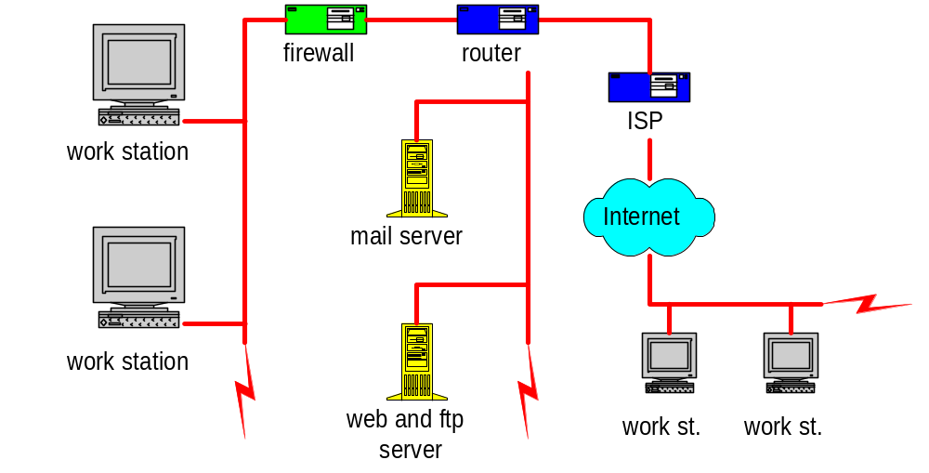
Packet Sniffing

Slide 22
Sniffing: Captured Passwords
Source IP.port
Destination IP.port
333.22.112.11.3903-333.22.111.15.23: login [root]
333.22.112.11.3903-333.22.111.15.23: password [sysadm#1]
333.22.112.11.3710-333.22.111.16.23: login [root]
333.22.112.11.3710-333.22.111.16.23: password [sysadm#1]
333.22.112.91.1075-333.22.112.94.23: login [lester]
333.22.112.91.1075-333.22.112.94.23: password [l2rz721]
333.22.112.64.1700-444.333.228.48.23: login [rcsproul]
333.22.112.64.1700-444.333.228.48.23: password [truck]
Notes:
A careful look at the destination addresses reveals that some target machines are inside the LI-COR network, and others are outside.

Slide 23
Hacker Resources
Web sites with hacker tools:
  Kevin Kotas’ favorite sites:
    http://technotronic.com/
    http://security.pine.nl/
    http://astalavista.box.sk/
    http://Freshmeat.net/
  http://www.rootshell.com
  http://oliver.efri.hr/~crv/security/bugs/list.html
  http://www.phrack.com/
  http://www.securityfocus.com/
    click on “forums”, then “bugtraq”
  http://main.succeed.net/~kill9/hack/tools/trojans/
IRC
  #hacker*

Slide 24
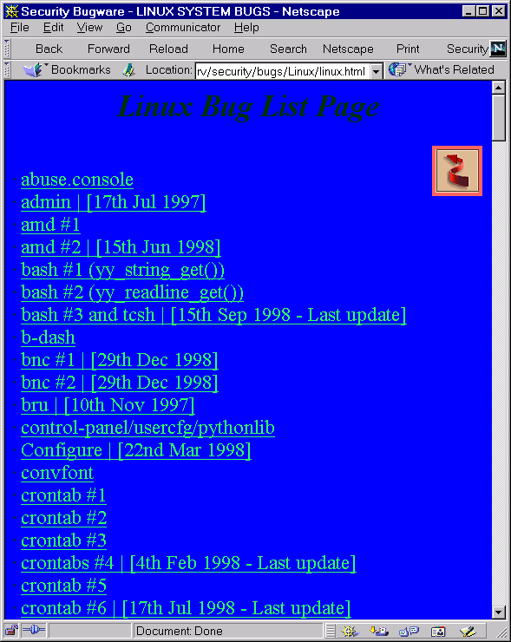

Slide 25


Slide 26
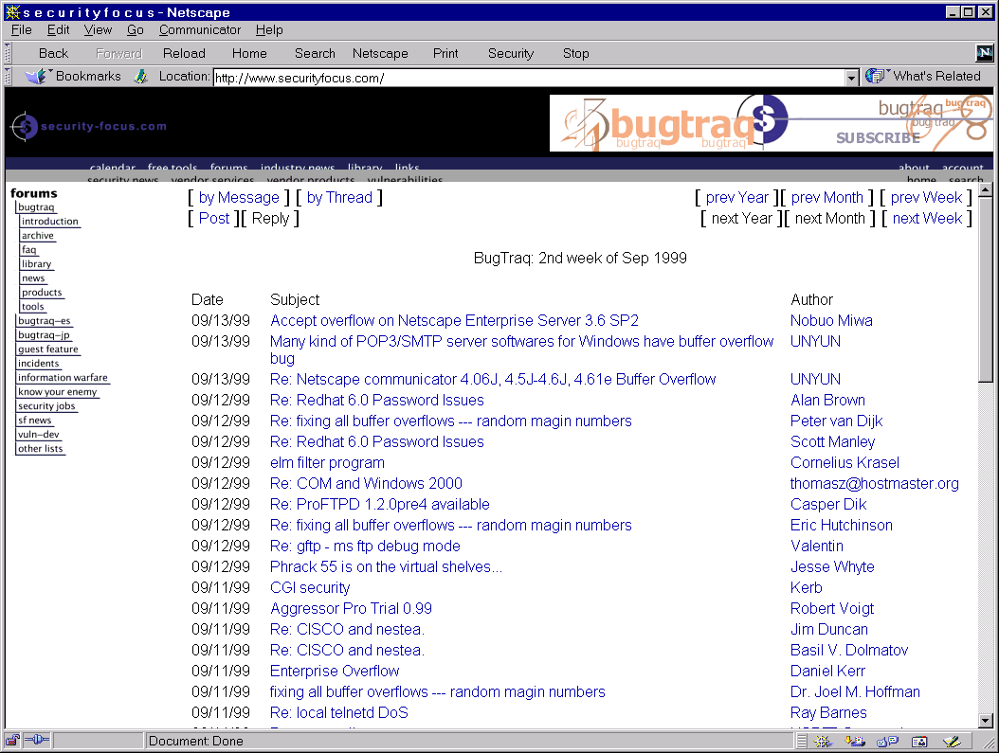

Slide 27
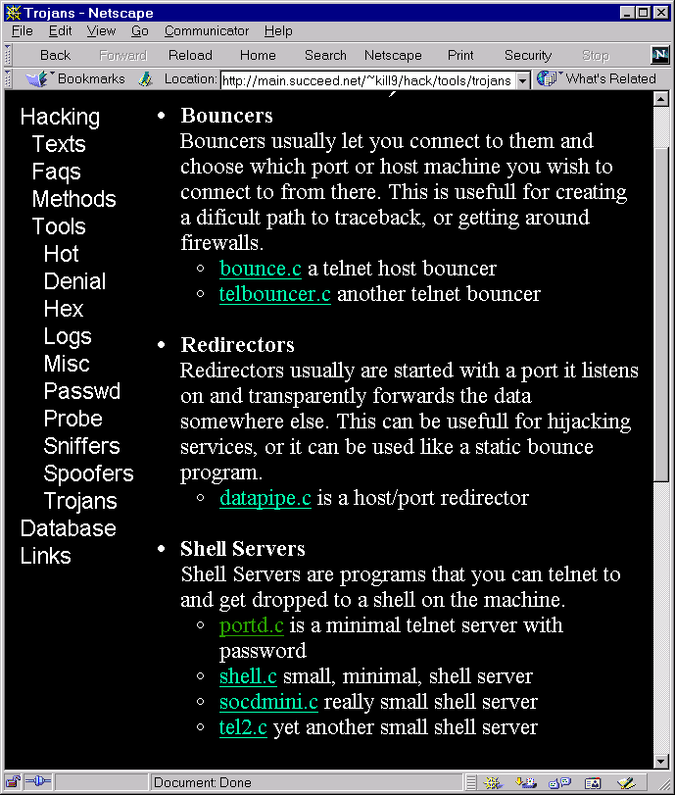

Slide 28
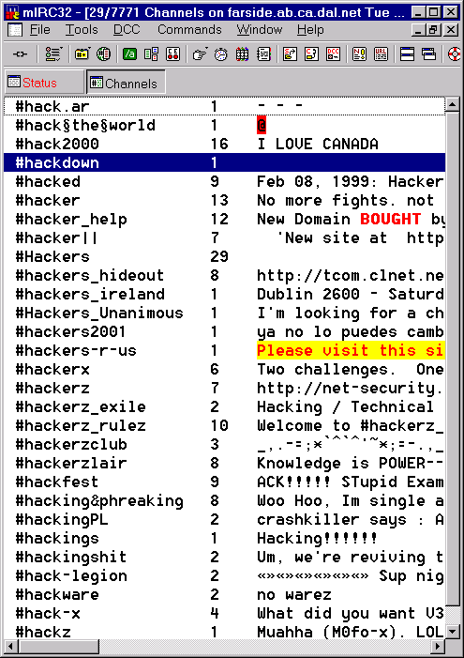

Slide 29
Hacker Techniques
Find and attack the “weakest link”
Reconnaissance
Gain access to first machine,
Use acquired access to gain further access

